Slide 1
NxStage Cartridge Express and Cartridge with “Speedswap™” Filter Exchange Feature
Cody Ger

Slide 2
Problem and Scope
Problem:
Filter clotting/clogging in long duration renal treatment is unavoidable and results in discontinuation of treatment.
Speedswap kit:
A feature in the cartridge design that allows the user to exchange a filter that is starting to clot/clog with a new previously primed filter
Minimizes interruptions in renal treatment
My role:
Prototype and testing
Update design changes into Agile

Slide 3
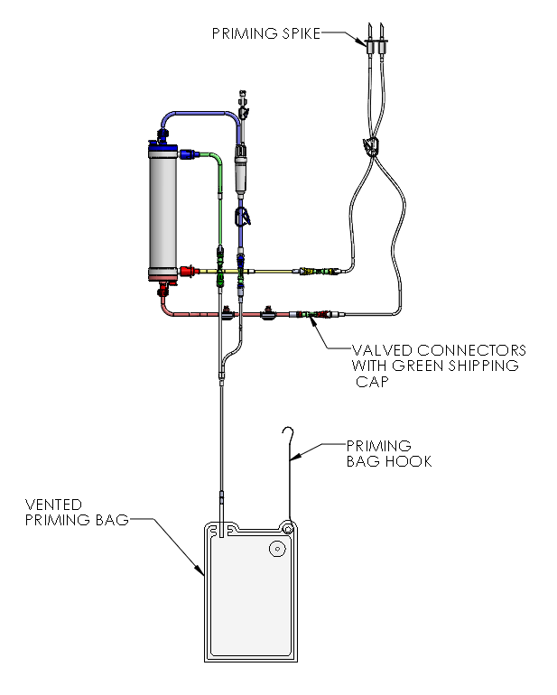
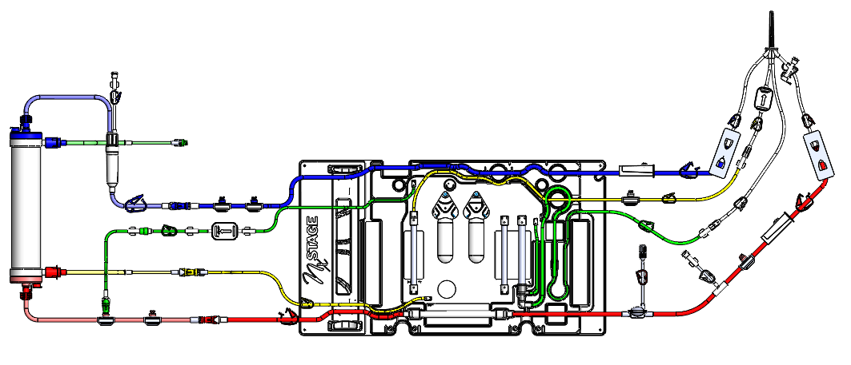
The Speedswap Cartridge Standard Kit
CAR-534
Based on the Modification of the CAR-535 configuration for use with stand alone filters
SSK-534
Includes tubing with connections for use with stand-alone filters and waste bag to collect spent prime fluid

Slide 4
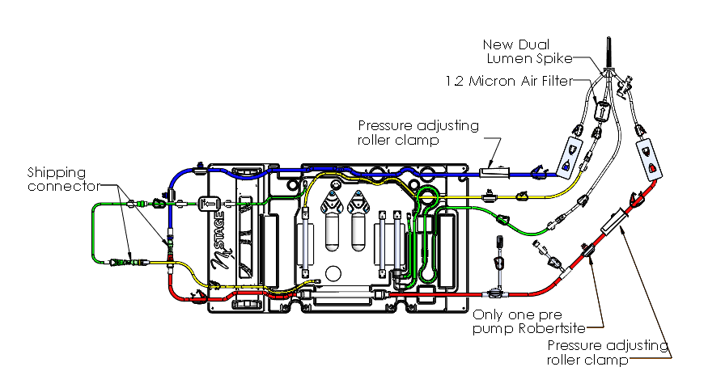
Speedswap Design Specifications
To avoid misconnections of various dialyzer tubing
Tubing lengths will be adjusted to prevent entanglement or improper connection
Male and Female Luer valves on CAR-534 and SSK-534 to be shipped disconnected but attached together with a connector
Valve connector polarity will be alternated to prevent improper connections
Original Concept

Slide 5
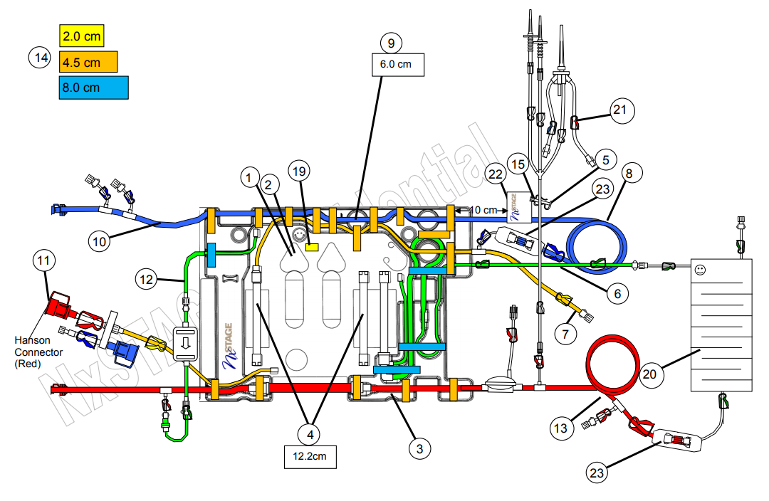
CAR-534 and CAR-124-C comparisons
2
1
5
5
6
4
4
4
4
4
1
Modification of tubing length (Venous and Arterial Lines)
Air Chamber implemented
Priming Spike assembly replaced (NX25-0324 to NX25-0937)
Post pump arterial Tee assembly replaced with Robert sites
Roller-clamp assemblies implemented
Green Shipping Connectors (NC10-1091) implemented

Slide 6
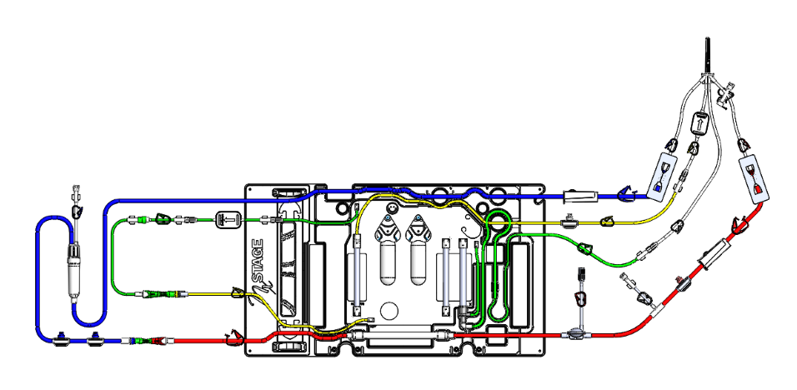
First Prototype of CAR-534
Created a prototype of CAR-534 using CAR-535
Did not modify any lengths from CAR535
Air Chamber added onto filter side of cartridge
Moved the location of the venous line robertsites
Result
Arterial line was too long, blocking paths of other tubing lines
Venous line from the air chamber to cartridge was too long and caused entanglement
Air Chamber was spliced into too close to the cartridge
Made it hard for the user to attach it to the System1 One

Slide 7
Second Prototype of CAR-534
Differences
Modified venous line (NX25-0792) tubing’s length (NC10-132) from 1.53m to 1.61m. Extension of 8 cm
Modified arterial line (NX25-0794) tubing’s length (NC10-132) from 2.15m to 2.04m. Shorten by 11cm
Air Chamber adjusted to be 12cm away from venous line robertsites and moved into cartridge venous lines
Minor design changes
Flipped the roller-clamps on the venous and arterial line
Implemented green shipping connectors NC10-1091 into design
Results
Very little to no entanglement or need to stretch out any

Slide 8
SSK-534
Purpose:
To collect spent prime fluid when changing the filter
Design specifications:
The waste bag will be sized to stop fluid flow automatically to prevent emptying of filter during manual filter prime
Waste bag will include a vent port to purge air during prime
*Chamber no longer in the SSK

Slide 9
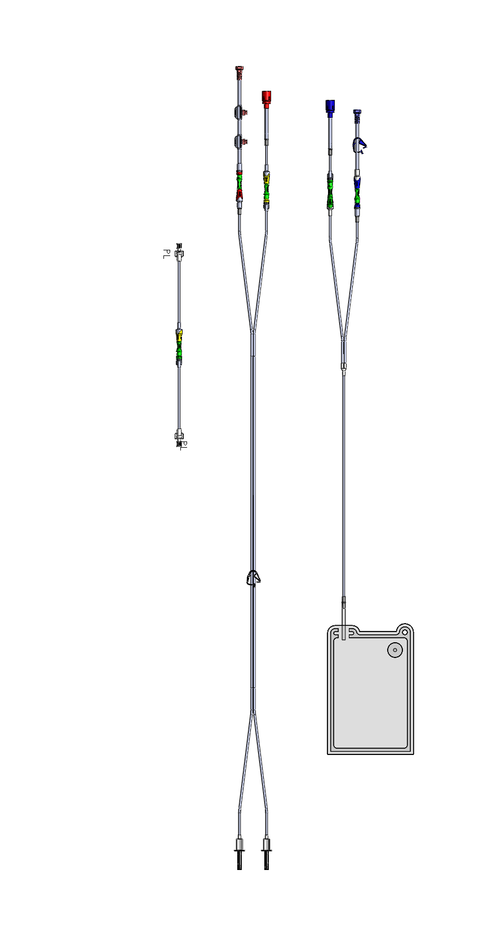
Prototype of SSK-534
Created a prototype of SSK-534
Did not modify any lengths from SSK-534
Results
No entanglement of any lines so no lengths were in need of adjustments
Further Design changes
Green shipping connectors implemented

Slide 10
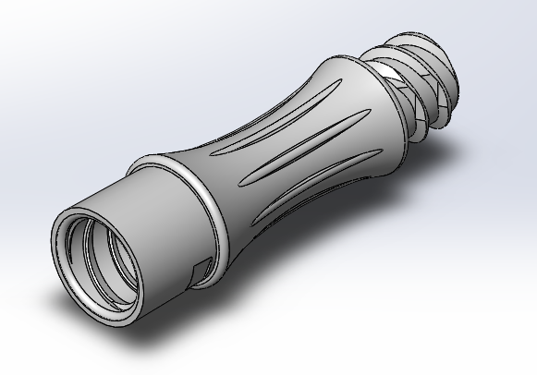
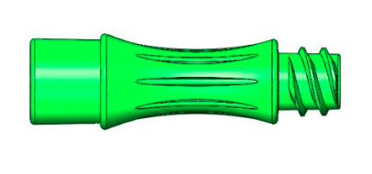
NC10-1091 Shipping Connector
Purpose:
Keep make and female luer valves connected and to protect sterility of valve surfaces during shipping and storage
Design specification:
Thread design implemented in both ends of connector
Tests performed
TP0031 Ship test
Bacterial challenge
Notes:
Include Ship Testing
Problems with molding

Slide 11
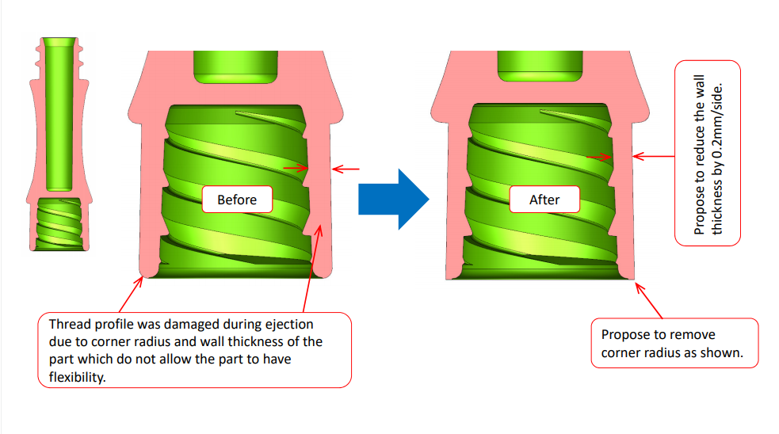
Design changes of NC10-1091
Design comments from Sunningdale

Slide 12
Design changes of NC10-1091

Slide 13
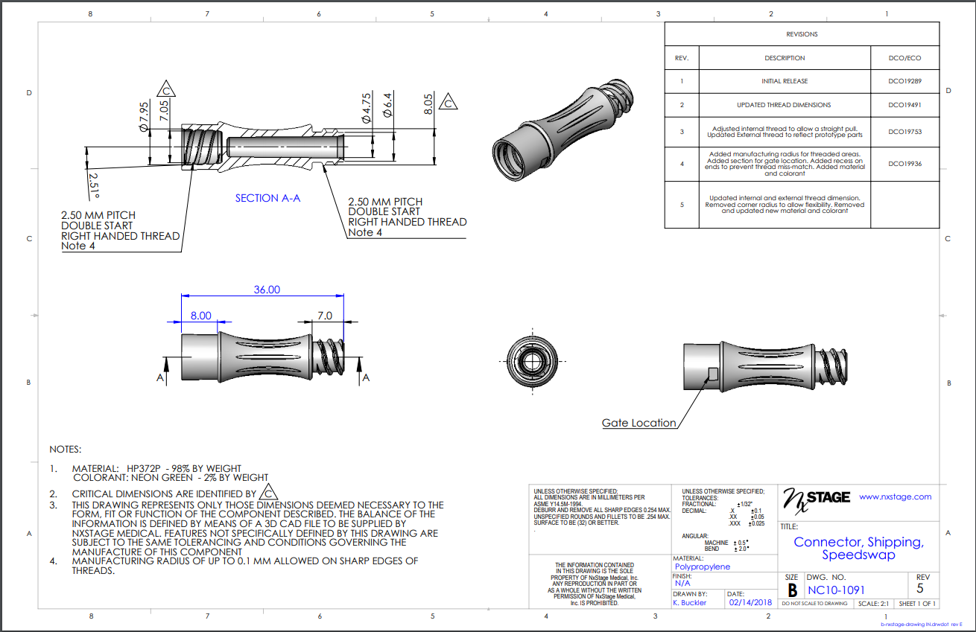
NC10-1091

Slide 14
TP0031 Test on Shipping Connector
Shock Testing:
Product weight: 6.1 kg
Drop Height: 38 inches
Results:
No disconnections observed. Test passed

Slide 15
Conclusion
Specifications of CAR-534:
To avoid misconnections of various dialyzer tubing
Tubing lengths have been adjusted to prevent entanglement or improper connection
How it was met
Prototyping and adjusting design per review with critical care manager of education and training
Design specifications of SSK-534:
The waste bag will be sized to stop fluid flow automatically to prevent emptying of filter during manual filter prime
Waste bag will include a vent port to purge air during prime
Design specification of NC10-1091:
Updates made to part design to reflect feedback from molder for improved manufacturing

Slide 16
THANK YOU!

